Slide 1


Sentiment Analysis of Amazon Customer Reviews using Transformers
Term Project – Natural Language Processing
Team Members:
Ajay Kumar Reddy Punuru
Keerthi Balabhadruni

Slide 2

Sentiment Analysis
Sentiment Analysis is the most common text classification tool that analyses an incoming message and tells whether the underlying sentiment is positive, negative or neutral.

Slide 3
Understanding the Classification of Sentiment Analysis
Raw Statement | Sentiment
I don’t like the way of approach | Negative
I like the way they explain the video | Positive
The video is ok but not as expected | Neutral

Slide 4

Project Objective
As Amazon grows, it gets a lot of reviews from customers. These reviews are important for understanding customer expectations and improving engagement. However, not all reviews are useful.
The main goal of the project is to analyze the sentiment of customer reviews on Amazon products using transformer-based models. This involves classifying each review as positive, negative, or neutral based on the text content.

Slide 5
Why is this project worth doing?
This project is worth doing for several reasons:
1. Understanding Customers: This project helps businesses understand what customers like and don't like about products sold on Amazon by analyzing their reviews.
2. Improving Products: By knowing what customers think, businesses can make their products better, which can make customers happier and more likely to buy again.
3. Beating the Competition: Knowing more about customers than competitors can help businesses attract more customers and do better in the market.
4. Making Customers Happier: By listening to what customers say, businesses can fix problems and make customers happier, which can lead to more sales.
5. Better Marketing: Understanding what customers like can help businesses advertise and sell products more effectively.
6. Decision Making: Listening to customers can help businesses make smarter decisions about what to do next.

Slide 6
Project Plan to build Classifier Model
Collecting and Preprocessing of Data
Sentiment Analysis
Error Detection and Correction
Categorization by Sentence Type
Filtering Poorly Constructed Reviews and Presenting

Slide 7
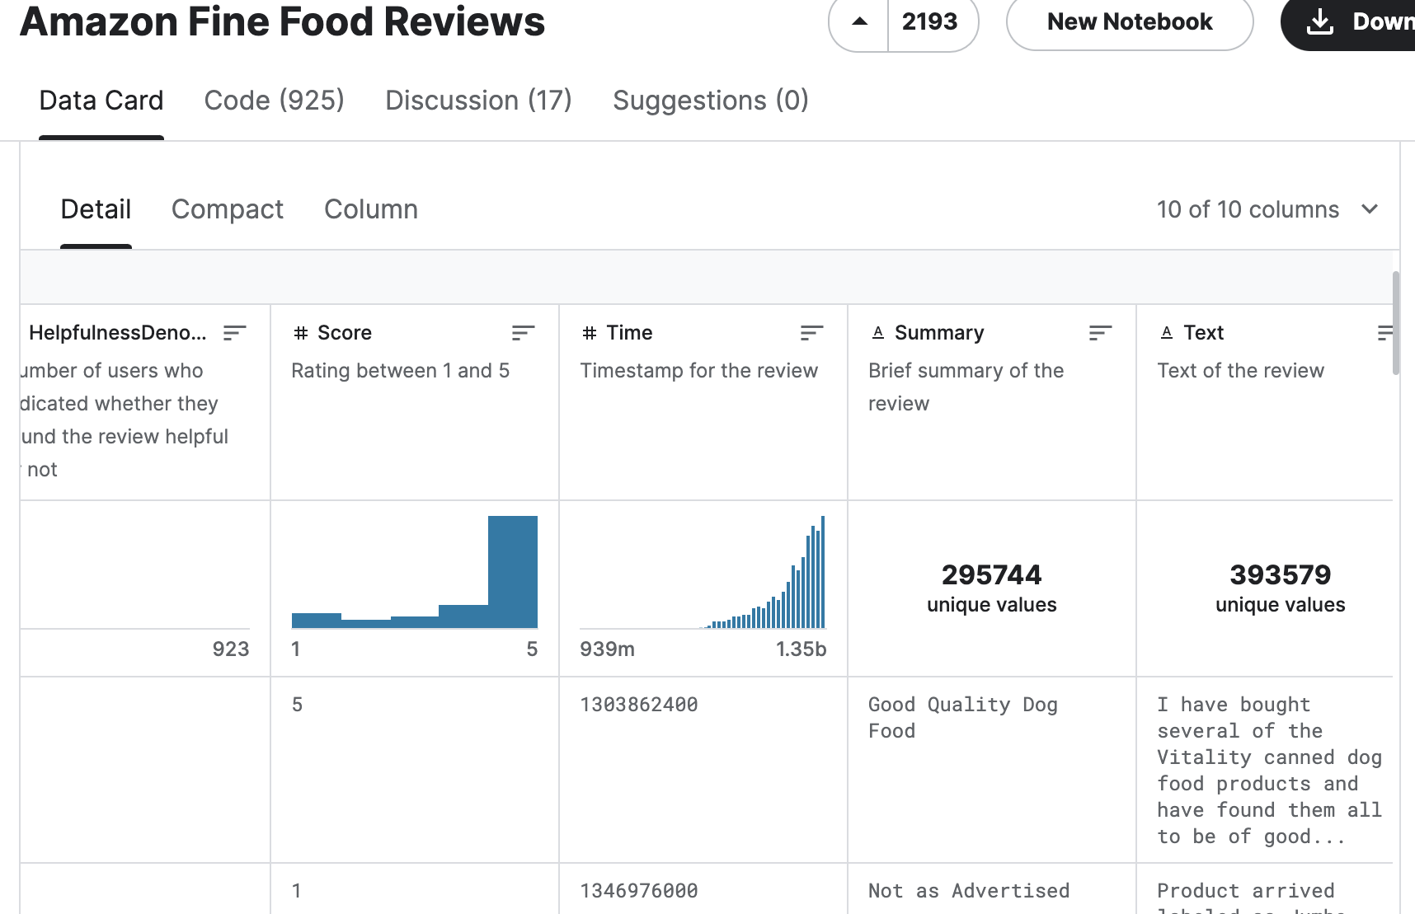
Dataset Sample
We have taken the datasets from Kaggle.
Link: https://www.kaggle.com/datasets/snap/amazon-fine-food-reviews

Slide 8
Tools
Natural Language Toolkit (NLTK)
Transformers library from Hugging Face [ VADER and Roberta Pretrained Model]
Jupyter Notebook

Slide 9
Deliverables
Combine results from VADER and Roberta for comparison and analysis
Present a comprehensive evaluation report comparing the performance of VADER and Roberta models based on metrics such as accuracy, precision, recall, F1 score, and ROC-AUC curve.
Include visualizations such as bar charts, confusion matrices, and ROC curves to visually represent the model performance and provide interpretations of the results.
Final report detailing the sentiment analysis process, results, and analysis.

Slide 10
Evaluation Methodology
Accuracy is a commonly used metric for sentiment analysis. It measures the proportion of correctly classified comments out of the total number of reviews.
To calculate accuracy, use the following formula:
True Positives (TP): The number of positive sentiment comments correctly classified as positive.
True Negatives (TN): The number of negative sentiment comments correctly classified as negative.
Total Comments: The total number of comments in your dataset.
While accuracy is a useful metric, it's not always sufficient on its own, especially when dealing with imbalanced datasets (e.g., when one sentiment class is significantly more prevalent than the other). In such cases, it's essential to consider other evaluation metrics like precision, recall, F1 score, and the confusion matrix to get a more comprehensive understanding of your model's performance.
We assess how well our model can correctly classify customer reviews as positive, negative, or neutral sentiments.

Slide 11
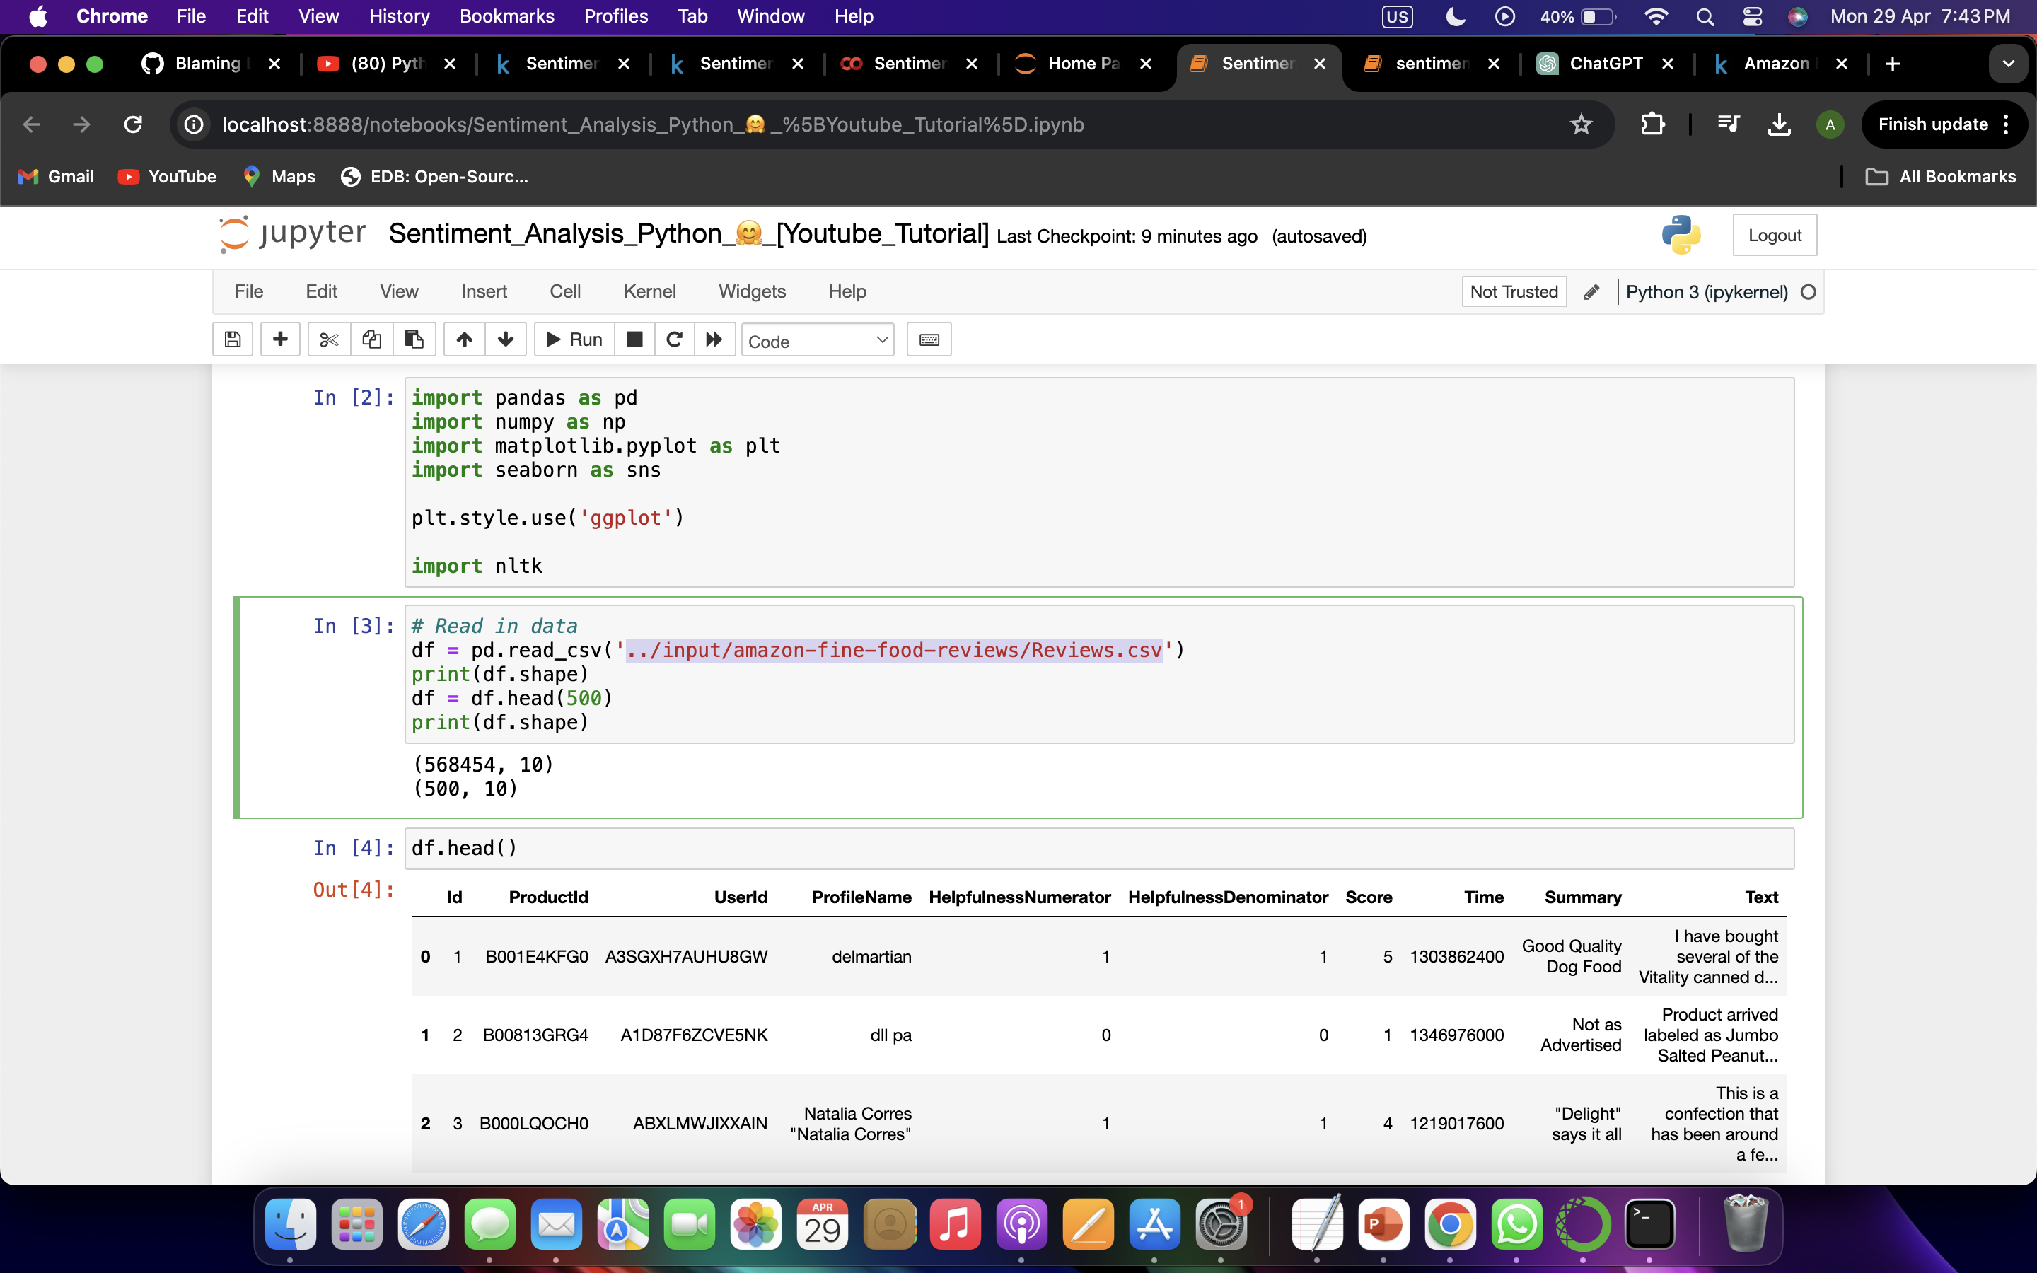
Read in Data and NLTK Basics

Slide 12
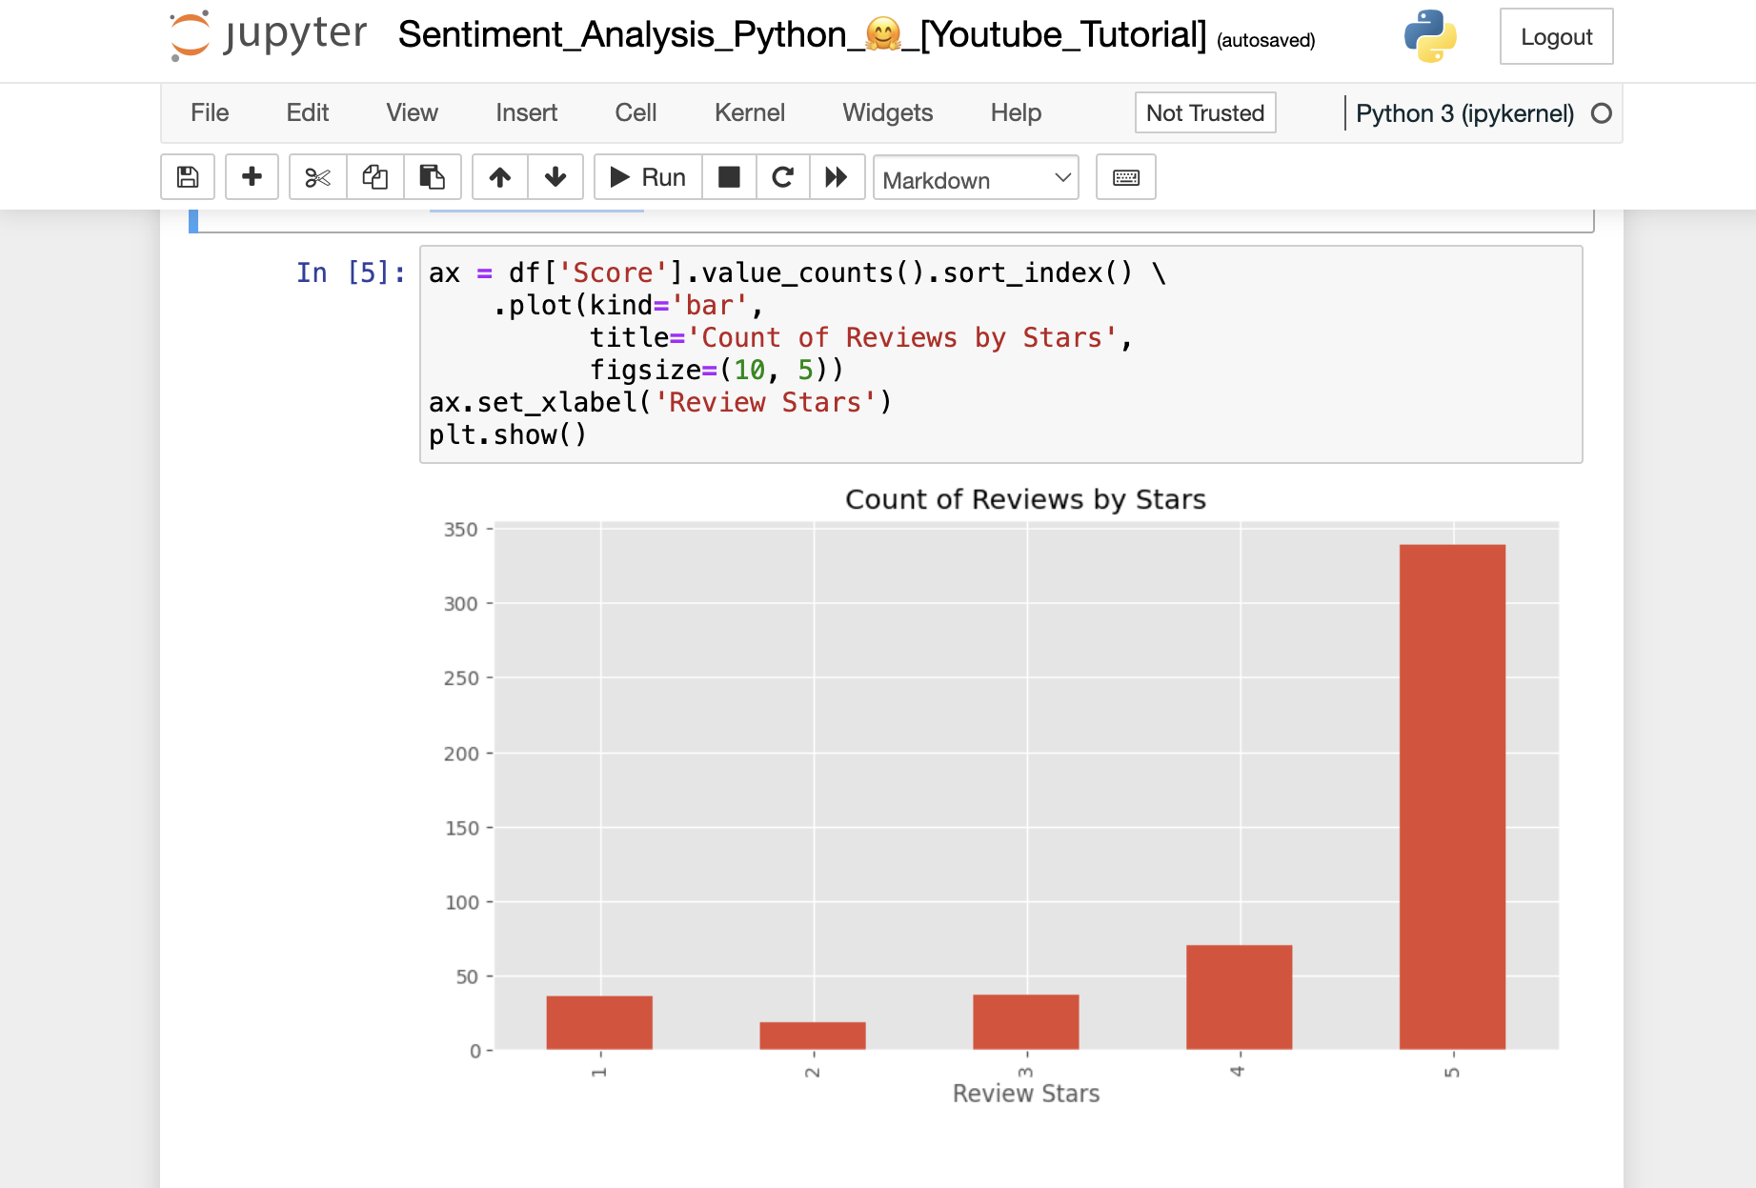
Quick EDA

Slide 13
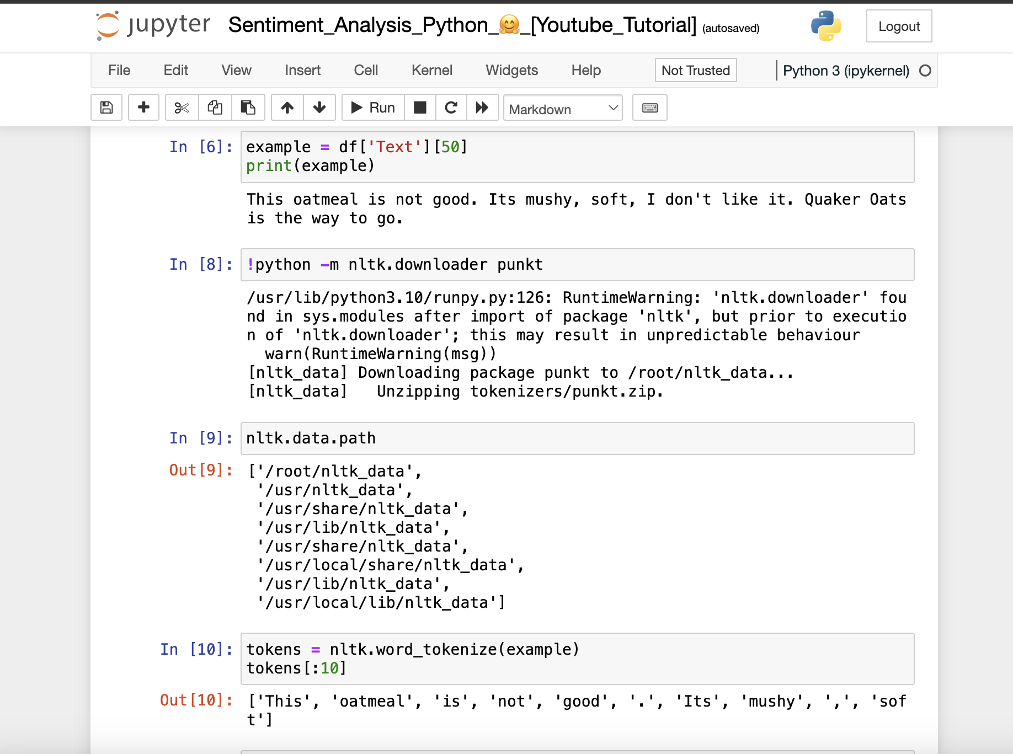
Basic NLTK

Slide 14
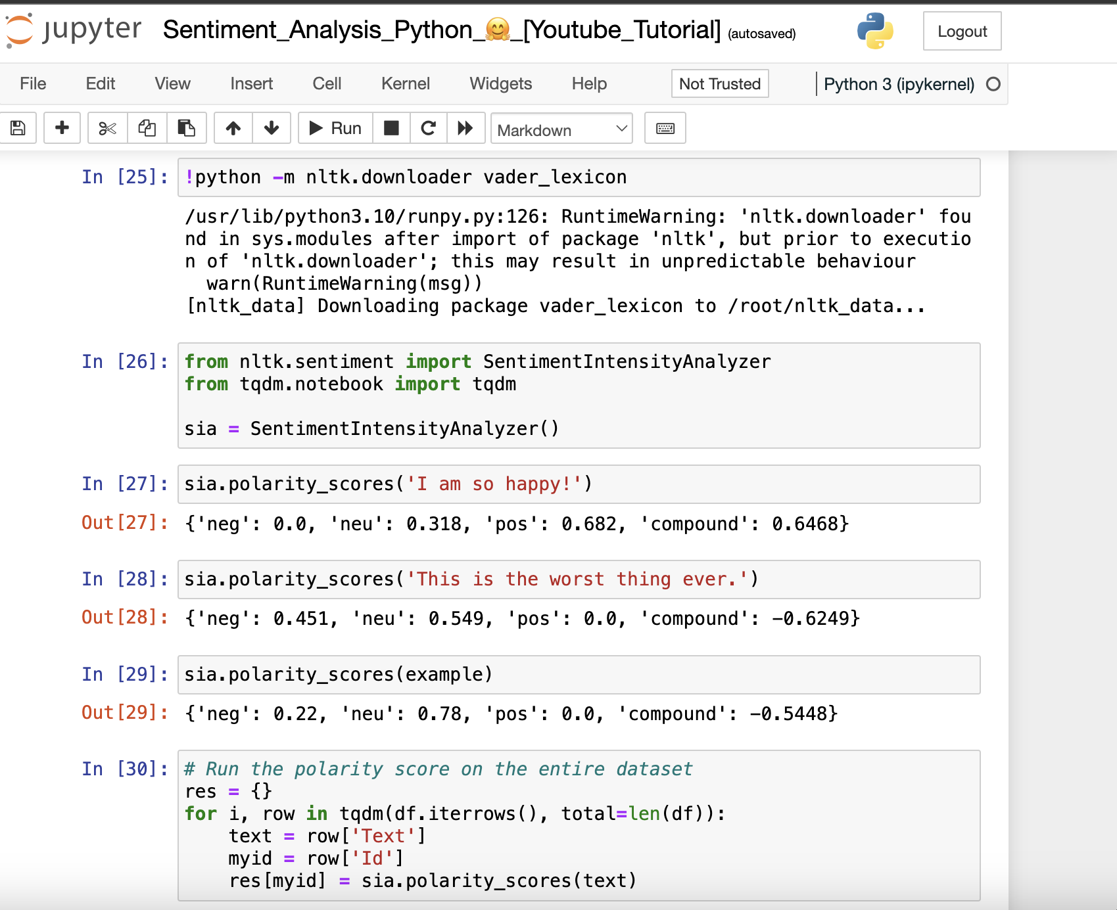
VADER Seniment Scoring

Slide 15
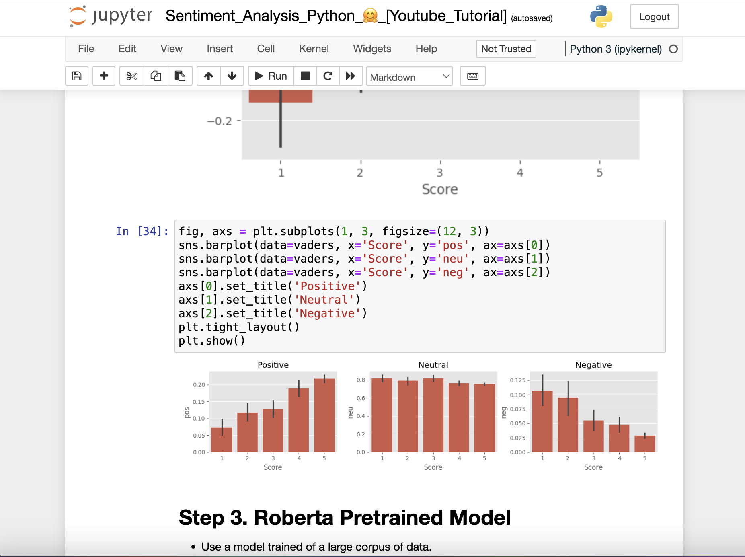
Plot VADER results

Slide 16
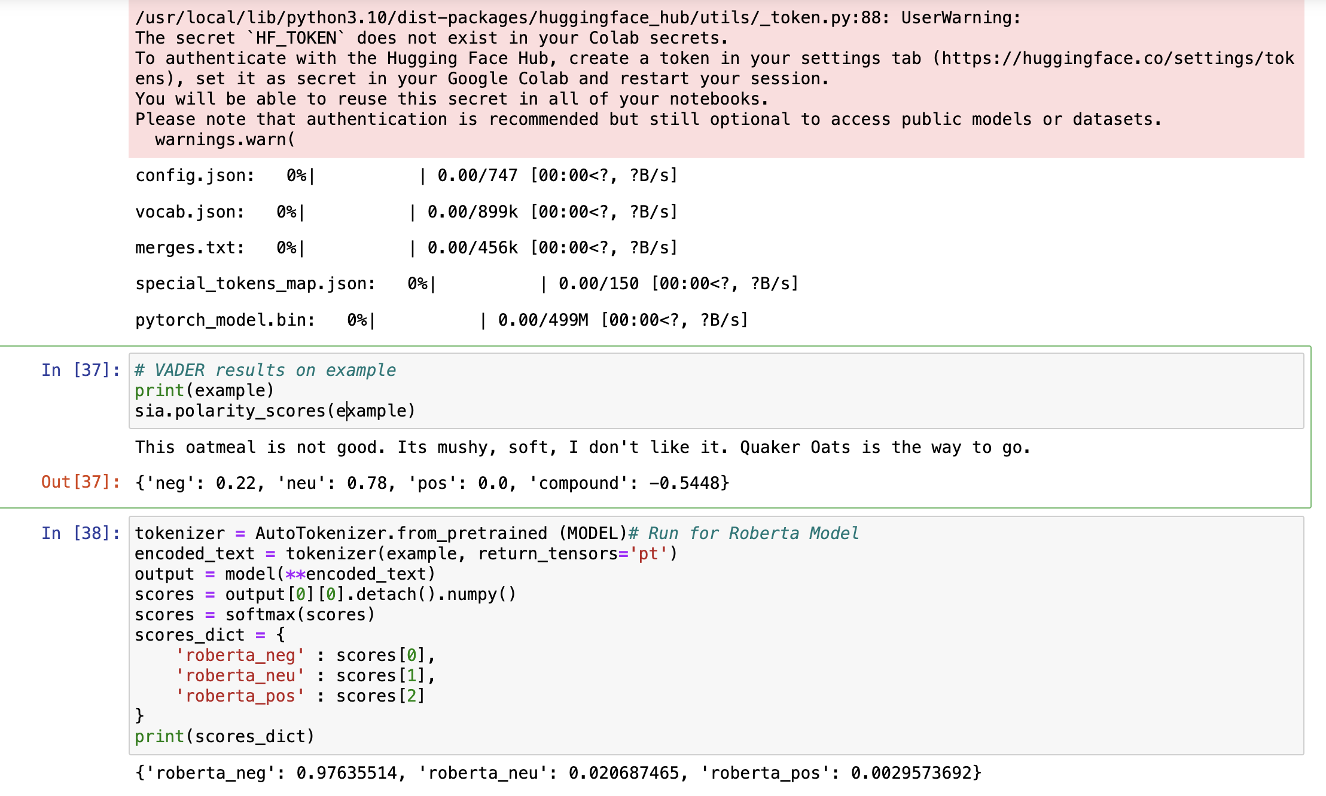
Roberta Pretrained Model

Slide 17
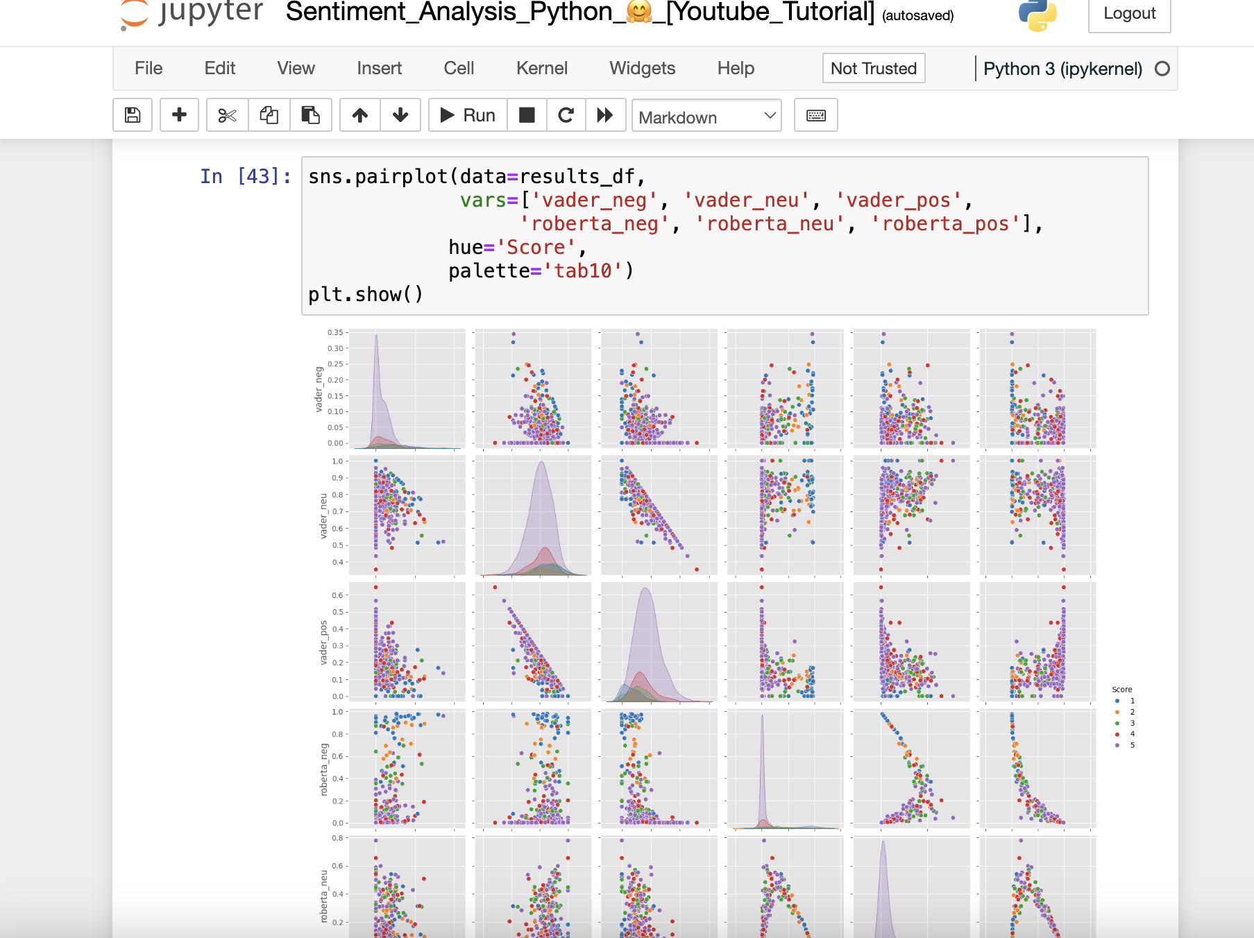
Combine and compare

Slide 18
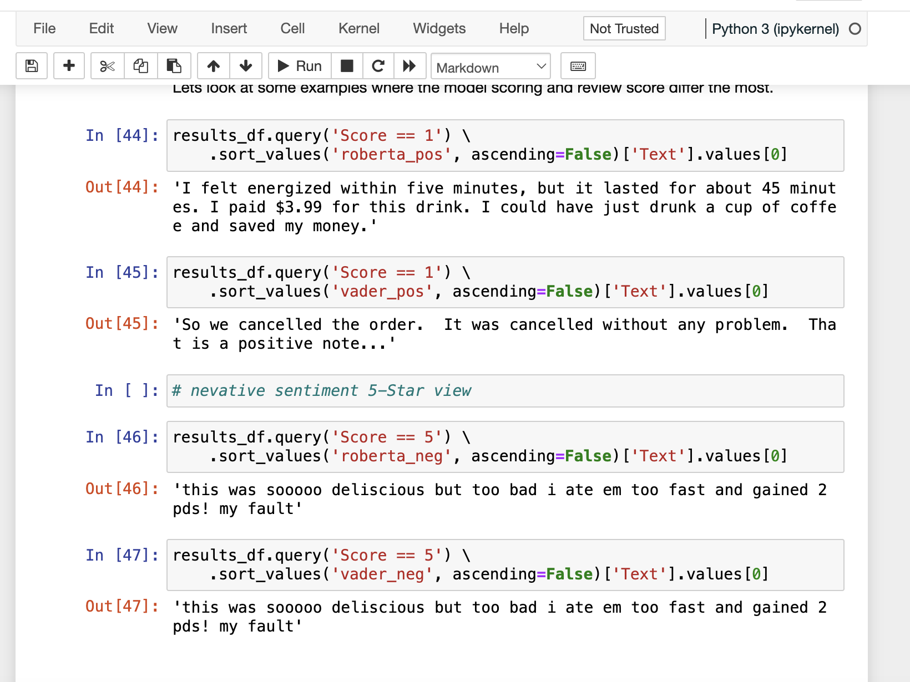
Review Examples

Slide 19
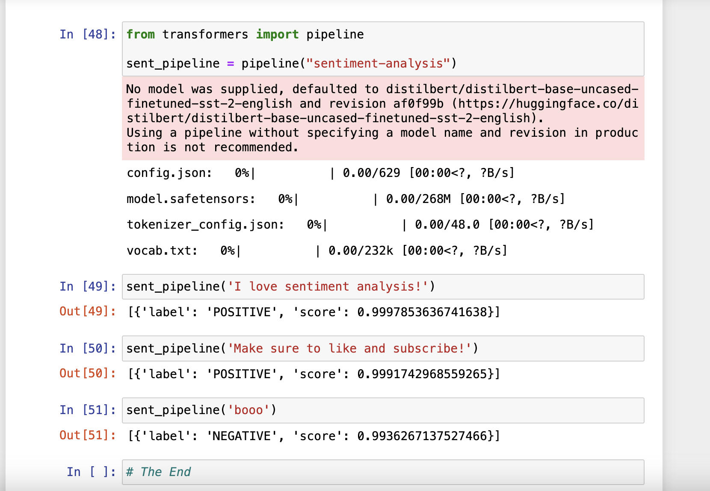
The Transformers Pipeline

Slide 20


